Slide 1
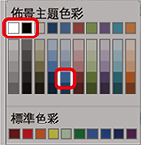
DS410f Series Industrial 6GF+2GC+2GT L2 Gigabit Managed Fiber Switch
字型：Arial / 微軟正黑
顏色：
字級：
大標題(粗體)：38pt
副標題：24pt
WoMaster PDM
Notes:
．字型：Arial / 微軟正黑 ． 顏色：請見封面頁右方標註

Slide 2
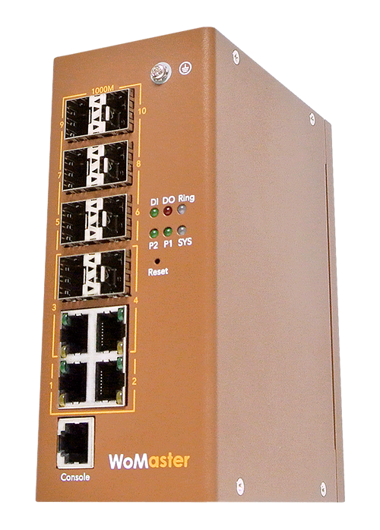
DS410f Product Overview
Rugged High Fiber ports Access switch for the field applications
Low Cost Industrial Switch for entry-level management switch
Up to 8x 100/1000M Fiber Ports, easy to aggregate end nodes with Fiber uplink
2 copper + 2x Copper combo with Fiber ports
SFP Copper Transceiver
L2 Management, VLAN, QoS, IGMP Snooping, LACP/Trunk, LLDP, Loop Protection…etc.
RSTP/STP recovery protocol
Cyber Security: 802.1x RADIUS, IP/Port Security, Port Enable/Disable, ACL
Link Failure Relay Output Alarm
Rugged Design with Dual 10~60Vin, -40~75ºC, IEC 61000-6-2/4 Heavy Industrial & EN50121-4 compliance
Optional 8xCopper DS410 By Request.
Optional Accessory includes Fiber SFP Transceiver, Copper SFP Transceiver and Media Convertor
DS410f
Notes:
DS410f/DS310: 3787/4976 = 76%
DS410f/DS612: 3787/6908 = 55%
DS410f/DS409: 3787/7961 = 48%

Slide 3
DS410f Product Appearance
10-port Full Gigabit Ethernet
DS410F:
・6-port 100/1000M SFP
・2-port 100/1000M SFP/RJ45 Combo
・2-port 10/100/1000M RJ45
DS410 (By Request):
・6-port 10/100/1000M RJ45
・2-port 100/1000M SFP/RJ45 Combo
・2-port 100/1000M SFP
System LED
・ 1 x DI
・ 1 x DO
・ 1 x Ring status
・ 2 x Power
・ 1 x System Status
DIN Clip
RS232 System Management Console
Integrated DI/DO Connector
・1 x 4-pin terminal block
2-pin for DI
2-pin for DO
Integrated Power
Connector
・1 x 4-pin terminal block for
redundant power input

Slide 4
Fiber Concern in Industrial Environment
Long Distance
Transmit signals across much greater distances than copper cables with little-to-no signal degradation.
Resistance to Interference
Heavy machinery may cause electromagnetic interference, Fiber signals do not degrade or disappear due to the interference.
Reliable
Not affected by environment change, ex: Temp., weather…
Not affected by Surge, ESD, EMI…
Security:
Need plug SFP
Fiber optic can’t snoop, need physically cut the fiber
Cost
The cost for fiber cable, components, and hardware is steadily decreasing.
Long distance fiber cost is lower than copper.
Notes:
Would-be hackers and information thieves can gain access to business cable Internet with relative ease, due to cable tapping or other relatively simple methodologies. The only way to penetrate fiber-optic Internet is to physically cut the fibers, which will cause the signal to disappear. Fiber-optic Internet is one powerful way to increase your company's protection against cyber crime.
Copper cable Internet that supports broadband is sensitive to electromagnetic interference, which can be caused by the proximity of heavy machinery. Fiber Internet signals do not degrade or disappear due to electromagnetic interference. If your organization shares a telecommunications room with other businesses, fiber-optic Internet can protect your connectivity from disappearing if other organizations are using equipment that can interfere with your connection in the same space.

Slide 5
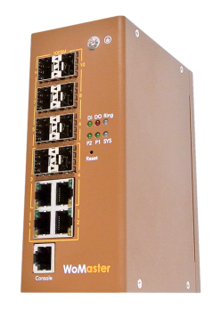
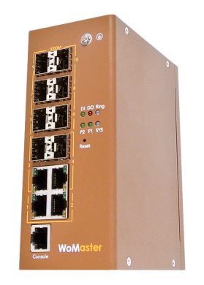
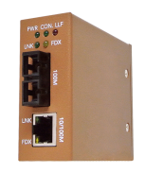
Fiber Construction Network
Central Room
Central Room
GbE Fiber
GbE Fiber
RSTP/STP
DS410f
Max.
8x Fibers
100M
Fiber
GbE
Fiber
Fiber uplink for remote central room
Fiber Optic Backbone network
Fiber downlink to the Field Box/Nodes
DS101/108/306/406…
Field Site

Slide 6
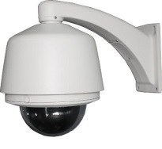
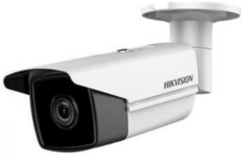
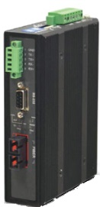
Fiber Optic Applications
RS428 Industrial Rackmount Switch
@ Control Room
Redundant
Uplink
DP101 Industrial
PoE
Media Convertor
DS101 Industrial
Media Convertor
DS108f
Fiber Switch
RSTP
Ethernet
Devices
3rd Party
Fiber Device Server

Slide 7
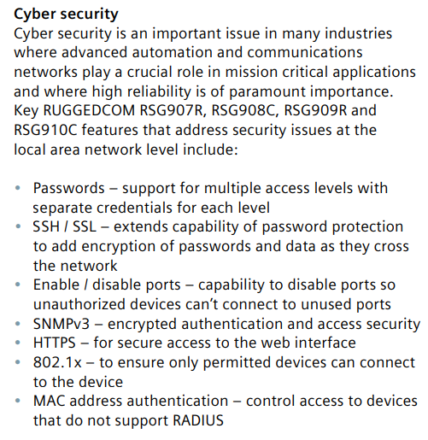
L2 Management Features
Management
Cyber Security
Various configuration paths, including WebGUI, CLI, SNMP
Layer 2 management features include VLAN, QoS, IGMP Snooping, LACP/Trunk…etc.
Rapid Spanning Tree protocol
Traffic management: Port classification, Port policing, Port scheduler, Port shaping, QoS control list, WRED,
LLDP topology control
802.1X/RADIUS port-based access control
IP Security/Port Security
HTTPs/ Management IP secure access
Enable/Disable port

Slide 8
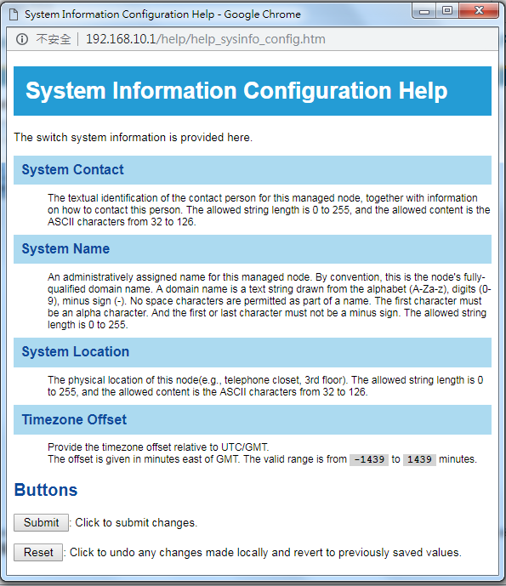
Simple Management Web GUI
HELP

Slide 9
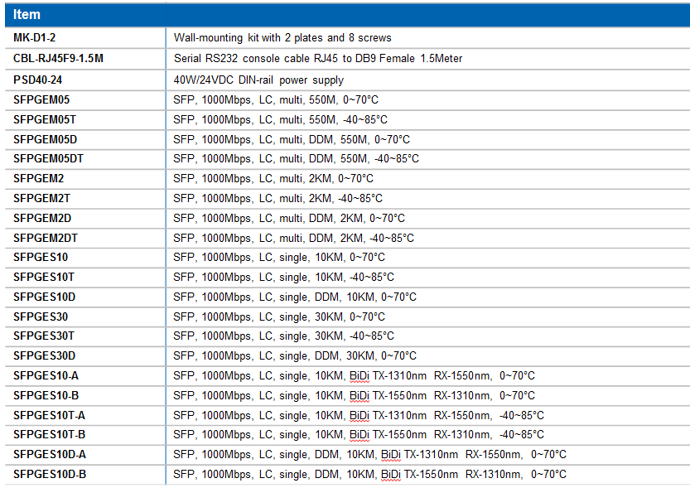
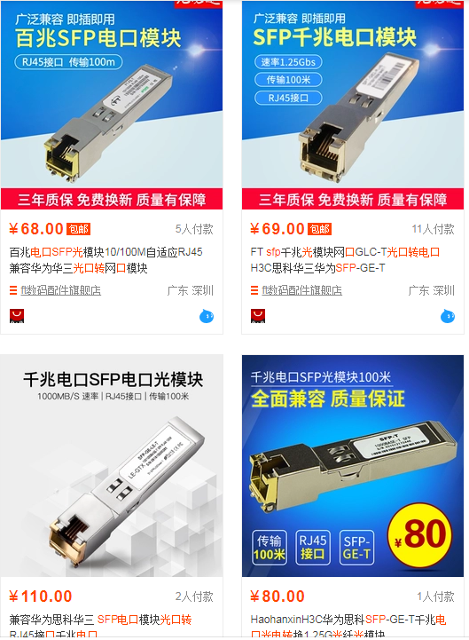
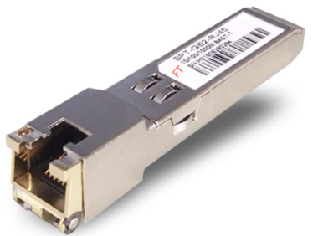
Optional Accessory:
Optional Fiber SFP
WoMaster 100M/1000M SFP Transceivers
Copper SFP Transceiver
WoMaster Standard Copper SFP Transceiver
Lower Stock for Switch
3rd Copper SFP Transceiver in China Market is popular.
Media Convertor/ Entry Unmanaged Switch with Fiber Optic Interface
DS101, Media Convertor
DP101, Media Convertor with 802.3bt PoE out
DS108f, 8FE+2x100FX SC type Fiber Transceiver
SFP+A+B+C+D+T - a/b(if Bidi) A: FE(100M), GE(1000M), XG(10G) B: S/M (single/multi) C: distance 05/10/30/40/80/110/120 (km) 05=0.5KM D:DDM T:wide temperature
New Copper SFP under approving test
Model | Description
SFPFER01 | SFP, 100Mbps, LC, RJ45 Copper, 100M, 0~70°C
SFPGER01T | SFP, 100Mbps, LC, RJ45 Copper, 100M, -40~85°C
SFPGER01 | SFP, 1000Mbps, LC, RJ45 Copper, 100M, 0~70°C
SFPGER01T | SFP, 1000Mbps, LC, RJ45 Copper, 100M, -40~85°C
Copper SFP
Transceiver
DS101/
DP101
DS108f
Notes:
100M/1000M SFP for selection
Lower stock by Copper SFP Transceiver
Media convertor for long distance end node

Slide 10
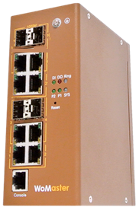
DS410 By Request
DS410f: High Fiber ports Access switch for the field applications, up to 8 Gigabit/100M Fiber ports
DS410: 8/7/6GT + 2/3/4 100/1000M SFP, up to 4 1000/100M SFP
2 Combo Port design, L2 Management, Cost Effective…
8xGiga SFP
DS410f
DS410
Notes:
6 Diàn 4 guāng
6电4光

Slide 11
DS410F, High Scalability Fiber Network

